Slide 1
How much do we really know about income inequality in Latin America?
Francisco H. G. Ferreira
London School of Economics and IZA
Based primarily on
“Seventy-five years of measuring income inequality in Latin America”
with Facundo Alvaredo, François Bourguignon, and Nora Lustig
LACEA 2023, Universidad Javeriana, Bogotá

Slide 2

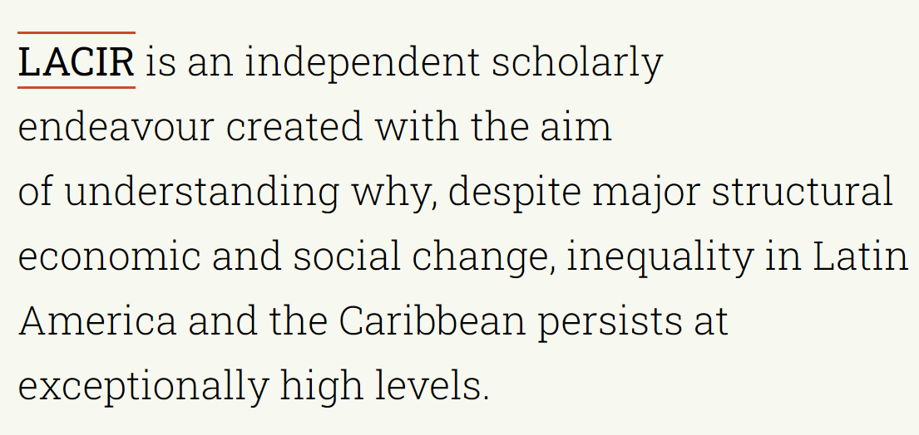
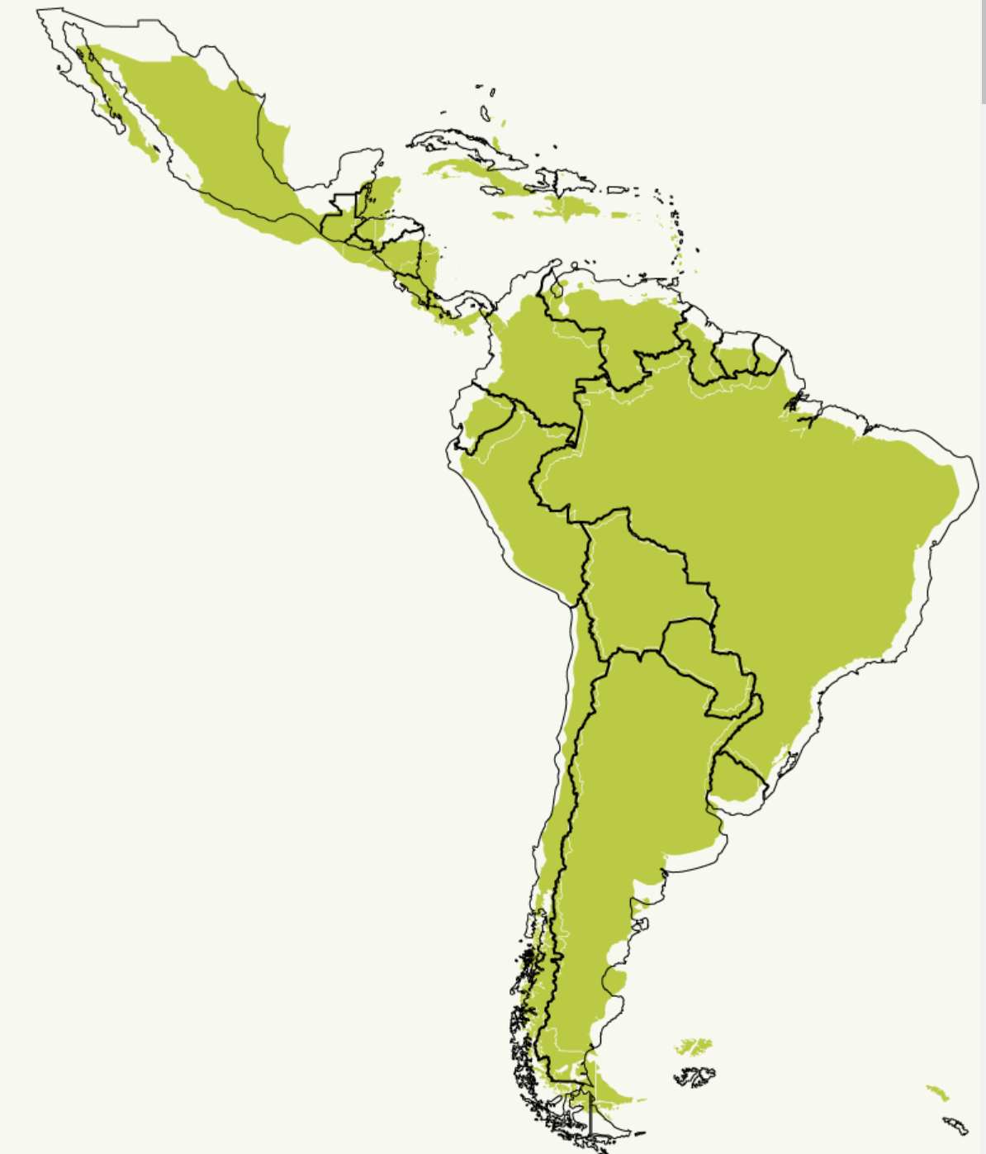

Latin American and Caribbean Inequality Review

Slide 3
Outline
Introduction
Sources of variation in estimates
Data
Household surveys
Tax records and National Accounts
Drivers: some brief speculation
Conclusions

Slide 4
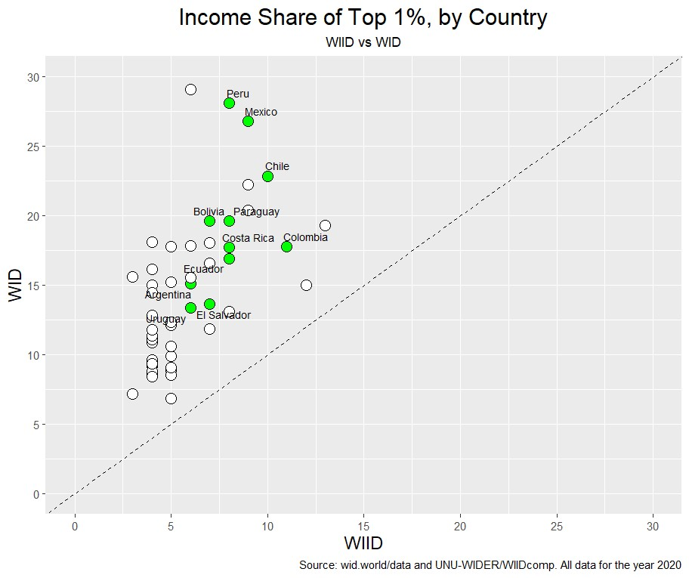
1. Introduction
Nowadays, income inequality estimates are widely available for a large number of countries
But they can differ staggeringly across sources
Top 1% income shares for all 53 countries for which data was available for 2020 in both the WIID and the WID
  Peru: (8%, 28%)
  Mexico (9%, 27%)
Source: Ferreira (2023): “Is there a ‘new consensus’ on inequality?”

Slide 5
1. Introduction:
Gini coefficients for Brazil, 1958 -2021

Slide 6
1. Introduction
In this project, we set out to review the statistical evidence on income inequality in LAC over the last seventy-five years or so.
Wide range of comparability issues across time and space, but…
… more worryingly, considerable heterogeneity of estimates for the same country-year combinations
In seeking to make sense of this landscape, our aim is to try to summarize what can be said with confidence about the levels and dynamics of income inequality in Latin America.

Slide 7
1. Introduction
In this project, we set out to review the statistical evidence on income inequality in LAC over the last seventy-five years or so.
Wide range of comparability issues across time and space, but…
… more worryingly, considerable heterogeneity of estimates for the same country-year combinations
In seeking to make sense of this landscape, our aim is to try to summarize what can be said with confidence about the levels and dynamics of income inequality in Latin America.

Slide 8
2. Sources of differences
Variety 1: Different data sources
  Household surveys
    Designed for purpose
    Good coverage of bulk of the distribution
    Large set of covariates
    Terrible (and worsening?) coverage of the top of the distribution
  Administrative data (e.g. tax records, social security, etc.)
    Much better coverage of the top of the distribution
    Very large numbers of observations
    Evasion and avoidance
    Excludes informal sector and those exempt from declaration
  National Accounts aggregates
    More comprehensive coverage of aggregate income flows in the economy
    Very little information on distribution

Slide 9
2. Sources of differences
Variety 2: Different concepts
  Different “individual welfare indicators”
    Household income – total
    Household income – per capita
    Household income – equivalized
    Individual labour earnings
    Consumption expenditures
    Etc.
  Different units of analysis
    Individuals
    Households
    Adults
    Heads and spouses

Slide 10
2. Sources of differences
Variety 2: Different concepts
Figure 1. Levels and dynamics of income/consumption inequality in the world 1990-2020
Figure 2. Inequality in the developing world around 2020: Gini coefficients of the distribution of household consumption per capita by region
Source: Ferreira, Lakner and Silwal (background work for World Bank PSPR) based on PovcalNet/PIP.
Source: Update of Alvaredo and Gasparini (2015), Gasparini et al. (2018) and Bracco et al. (2021) based on PovcalNet/PIP. Use adjustment factor of 0.861.from a subsample of countries.

Slide 11
2. Sources of differences
Variety 3: Different treatment of the same data / concepts
  Net or gross: treatment of taxes and social security contributions
    Remarkable opaqueness on this in many LAC datasets, beginning with questionnaires
  Treatment of ‘outliers’
    E.g., trimming or winsorizing
  Spatial price deflation
  Imputation of rents for owner-occupiers
  “Correction” of unit non-response
  Imputation of missing incomes
    Using ‘internal’ information
    Using information from other sources

Slide 12
2. Sources of differences
Variety 4: Different summary indices of inequality
  Quantile shares
  Gini coefficients
  Other summary indices
Source: Chile’s CASEN. (Ferreira & Litchfield, WBER 1999).

Slide 13
3. Data
Concerned with the variation in inequality estimates in LAC arising from Varieties 1, 2 and 3
Compiled a (meta) dataset of summary statistics
Built primarily upon:
  UNU-WIDER’s World Income Inequality Database (WIID)
  De Rosa, Flores and Morgan (2022): “More unequal or not as rich? Revisiting the Latin American exception” (Stone Center working paper 53)
  Also includes additional historical series and studies collected by the authors
64,332 observations (including quantile shares)
  5,630 Gini coefficients
  34 countries
  1948-2021
  Earliest: Guatemala (1948), Mexico (1950), Barbados (1951)
  Latest: 12 countries in 2021

Slide 14
Figure 3. Gini coefficients in Latin America and the Caribbean, 1948-2021

Slide 18
4. Household surveys
Region has a relatively long history of collecting household surveys
  Going back to the 1950s and 60s, initially with ad-hoc surveys run by universities or other institutions, typically for large cities. E.g., the Encuestas de Ocupación y Desocupación (1956 -1979), run by U. de Chile for greater Santiago.
  More systematic and institutionalized from the 1970s (in the pioneer countries), e.g., the EPHs in Argentina (from 1972) and the PNADs in Brazil (from 1976).
Giving rise to two broad phases:
  In the 1940s, 1950s and 1960s, Latin America followed the global pattern of studying the SNA and distributional issues together. Three examples:
    Argentina: CONADE-CEPAL (1965) estimated the personal and the functional distribution of income in detail for 1953, 1959 and 1961, using surveys, population and industrial censuses, income tax registries, and social security records, and the national accounts.
    Mexico: Based on the population census of 1950 and the income and expenditure surveys of 1956 and 1958, Navarrete (1960) investigated the distribution of income in Mexico, where the gap with the national accounts was imputed to the top of the distribution.
    Chile: Jadue (1959) produced “probable” distributions of income for the years 1940-1954, based on tax data and social security registries. As total and average income did not match those informed by the national accounts, adjustments were applied.
  From the mid-1970s: HHS are collected increasingly systematically; analysis gradually divorced from other sources

Slide 19
4. Household surveys
For the second phase, the WIID contains estimates from four ex-post harmonized time series, using HPCY as income concept, namely:
  SEDLAC (produced by CEDLAS at Universidad de la Plata)
  PIP, formerly POVCALNET (which is partly based on SEDLAC and thus similar, but not identical)
  CEPAL/ECLAC - new series: excludes that the old adjustment to top incomes
  LIS-Luxembourg Income Study, which has been progressively incorporated LATAM countries (namely Brazil, Chile, Colombia, Guatemala, Mexico, Panama, Peru, Paraguay and Uruguay)
In what follows, these series are highlighted in different colours. In addition:
  Blue dots are individual observations from different studies which use household income per capita (or near enough) as income concept
  Grey dots are observations that use other definitions of income (equivalized; total household income; consumption, etc.)

Slide 20
Figure 4. Predominantly HHS-based Gini coefficients in Latin America and the Caribbean

Slide 21
Figure 4. Predominantly HHS-based Gini coefficients in Latin America and the Caribbean

Slide 23
4. Household surveys
The dispersion in estimated can be summarized by two ranges:
  Band 1: the full annual range of the data, across all estimates
  Band 2: the annual range of estimates across the four harmonized series only
Across these eighteen countries and the full timespan:
  Band 1 averages 7.3 Gini points
    V2, V3
  Band 2 averages 1.9 Gini points
    V3

Slide 24
4. Household surveys: main take-aways (levels)
The variation within Band 1 excludes Varieties 1 (mostly) and 4, of the sources of differences.
The remaining variation (V2: concepts and V3: treatment of the same data) is much smaller than in Figure 3.
  V1, differences in data sources, account for a lot of the variation seen earlier
That said, seven Gini points is still a wide range: V2, concepts and definitions, also matter.
Once V2 is also eliminated, Band 2 is reassuringly narrow, but not zero!

Slide 25
4. Household surveys: main take-aways (trends)
Four periods:
  Period 0: 1950s to 1970s: information is too scarce and idiosyncratic for temporal patterns to be discerned
  Periods 1 and 2: Inverted U pattern: inequality rises during the 1980s and 1990s, falls during 2000s and 2010s – up to around 2015.
    But this is stylized. There is considerable heterogeneity across countries in the timing of peaks and troughs, and also in magnitudes of changes.
  Period 3: Divergence: from 2015 to 2021, we observe inequality stagnating, rising or continuing to fall, depending on the country.
These dynamic patterns are quite robust across the bands.

Slide 26
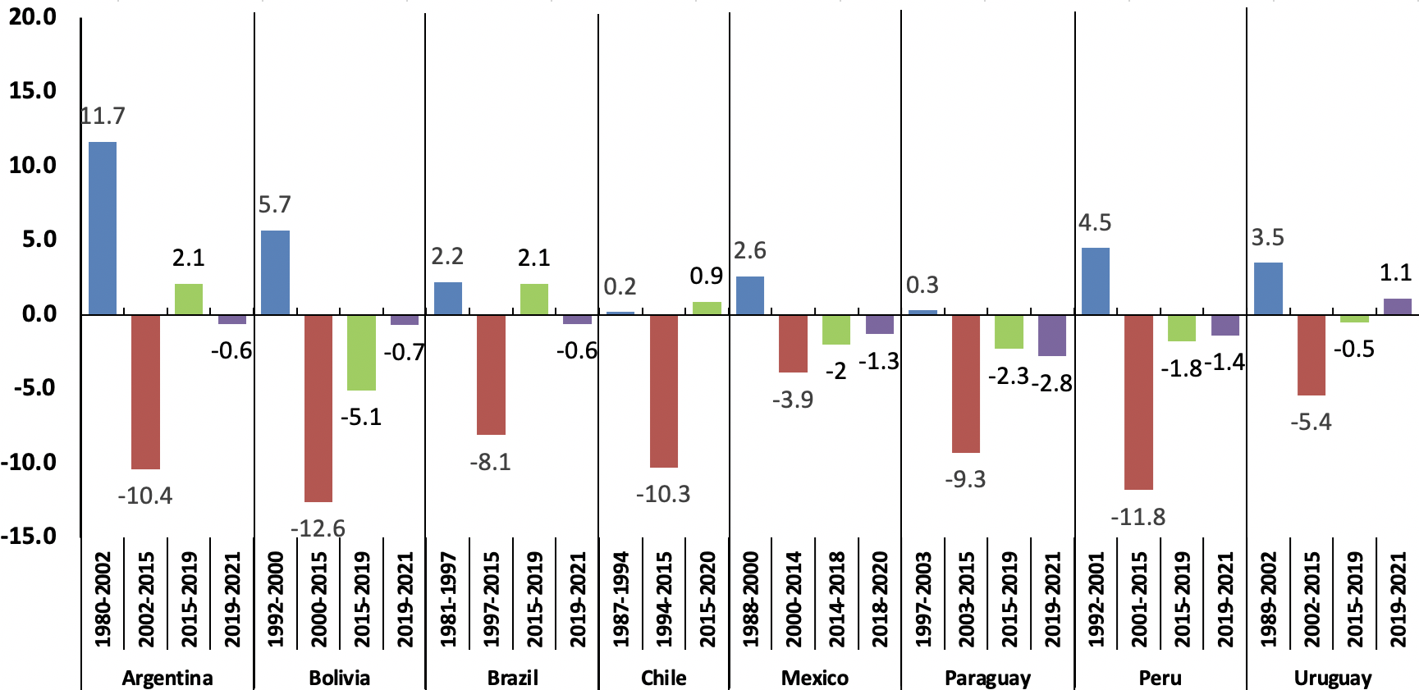
Figure 6. The rise and fall of income inequality in Latin America: 1980-2021
Changes in Gini coefficient (percentage points)

Slide 27
5. Incorporating tax data and NA aggregates
As part of the ‘top incomes’ literature initially associated with Tony Atkinson, Thomas Piketty and Emmanuel Saez, tax data has been brought to bear on the measurement of inequality in multiple LAC countries. E.g.:
  Argentina: Alvaredo (2010)
  Brazil: Souza and Medeiros (2017), Morgan (2018) and Morgan and Souza (2019);
  Chile: Fairfield and Jorrat (2016), López, Figueroa and Gutiérrez (2013), and Flores et al. (2020)
  Colombia: Alvaredo and Londoño-Vélez (2013, 2014) and Díaz Bazán (2015);
  Costa Rica: Zuñiga-Cordero (2018).
  Ecuador: Cano (2015, 2017) and Rossignolo, Oliva and Villacreces (2016);
  Mexico: Bustos and Leyva (2017);
  Uruguay: Burdín et al. (2022) and Flachaire, Lustig, and Vigorito (2022);

Slide 28
5. Incorporating tax data and NA aggregates
Both data and methodological challenges are substantial:
Data challenges (tax data):
  Data collected to assist with tax collection, so definitions depend on the tax code
    E.g., interest income often withheld at source, thus absent.
    Dividend income sometimes taxed through corporate taxes, otherwise through personal.
  Most importantly: all of the informal sector is missing.
Data challenges (National Accounts)
  Total HHS survey income accounts for 40-60% of total National Income (from SNA)
  Imputation requires distributing half of national income, most of which are items about whose distribution we know very little
  National account totals are themselves estimates, often calculated on the basis of strong assumptions and ‘residuals’. Particularly true for capital incomes.

Slide 29
5. Incorporating tax data and NA aggregates
Both data and methodological challenges are substantial:
Methodological challenges:
  Tax data: combining tax data and household survey is non-trivial and requires many judgment calls (e.g. Blanchet, Flores, and Morgan, 2022).
  Flachaire, Lustig, and Vigorito (2022):
    “The biggest challenge in applying correction methods is that – as the true distribution is unknown – the true threshold above which underreporting occurs is also unknown”
    “Our simulations show that if one chooses a threshold that is not close to the true one, corrected inequality measures may be significantly biased.”

Slide 30
Figure 11. Bottom 50% income share 2000-2020: household surveys and the effects of adjustments with administrative data and national accounts
We use the series constructed by De Rosa, Flores and Morgan (2022) for ten of the 34 countries examined earlier, largely because the assumptions and methods are consistent across countries.
Source: Series from De Rosa, Flores, and Morgan (2022)

Slide 31
Figure 7. Gini coefficients in Latin America 2000-2020. Household surveys and the effects of adjustments with administrative data and national accounts
Source: Series from De Rosa, Flores, and Morgan (2022)

Slide 32
Figure 7. Gini coefficients in Latin America 2000-2020. Household surveys and the effects of adjustments with administrative data and national accounts
Source: Series from De Rosa, Flores, and Morgan (2022)

Slide 33
5. Tax data and NA aggregates
Figure 12. Average width of inequality bands over 2000-2020: among HHS-based measures; including tax adjustments; and including scaling up to SNA aggregates.
Combining tax and HHS data in this fashion essentially has a level effect.
So does scaling incomes up to National Income totals, by distributing missing capital incomes and undistributed profits.
For these ten countries, during 2000-2020:
  Band 2 averages 1.7 Gini points
  Band 3 averages 10.4 Gini points
  Band 4 averages 16.9 Gini points
But the basic dynamic pattern (declining inequality from 2000-2015, with divergence thereafter) survives, with the possible exceptions of Mexico and Chile.

Slide 34
6. Drivers: some brief speculation
The subject of many of the other 27 papers in the LACIR project.
  Not preempted here.
That said, the ubiquity of the inverted-U pattern between 1980 – 2015 suggests there must have been some common factors.
  Structural:
    Period 1: economic liberalization, privatization, etc.?
    Period 2: educational expansion; expansion of social transfers.
  Shocks:
    Period 1: Oil price shocks (1973, 79); high global interest rates and the debt crisis; 1980s stagflation
    Period 2: Rise of China, commodity price boom.

Slide 35
6. Drivers: some brief speculation (e.g., Brazil)
(i) more and better-targeted social protection (e.g. Bolsa Família);
(ii) supply of skills outpacing demand…
Source: Ferreira, Firpo e Messina (2022)

Slide 36
… (iii) rising minimum wages (but only after 2002)
Minimum wages rose throughout the period, but before 2002 rising non-compliance reversed the effect.
Population mass below the minimum wage was 12% in 1995-96, 18% in 2002-03, and 16% in 2011-12
Fonte: Ferreira, Firpo e Messina (2022)

Slide 37
7. Conclusions
There is considerable variation in income inequality estimates in LAC – even for the same country/year cells.
  Some of this is due to variations in income concepts and definitions, and some to differential treatment of the same data by different analysts
  But the bulk of the differences are due to the use of different data sources and combinations thereof – now as in the 1960s…
It is now clear that statistics based on household surveys alone are likely to substantially underestimate inequality in the region.
But, because results have been shown to be sensitive to different combination and imputation methods, it is not clear that the recent ‘synthetic’ estimates represent credible, robust point estimates of the true level of inequality – at least not yet.
Therefore, some of the variation within (or beyond?) the bands we have described represents genuine uncertainty about income inequality levels.

Slide 38
7. Conclusions
Recent progress in the measurement of income inequality in the region is real, but incomplete: we now know we were wrong before, but we don’t yet know ‘the truth’.
Trends appear much more robust than level estimates, at least between 1980 and 2015.
  An inverted-U pattern is widespread, and likely due, at least in part, both to common structural changes and common global shocks.

Slide 39
Thank you very much.

