Slide 1
Leveraging Private Sector Data to Help Inform Major Social Challenges
John A. List, U. Chicago, JILAEE, ANU, and NBER
@Econ_4_Everyone

Slide 2
Today’s Agenda
Three Examples A. Value of Time
B. Economics of Crime
C. Project Gigaton
2. Epilogue: Summary of the Value of Field Experiments in Partnership with Firms
Thesis: crucial low hanging fruit wherein academics and businesses can team up to advance our understanding of critical social issues
→ We should be doing much more of this kind of research

Slide 3
A. The Value of Time

Slide 4
The value of time (VOT) is an important concept throughout the social sciences and economics, and important to policymaking
Since David Green (QJE, 1894), economists have assumed VOT is constant for each individual – i.e., their wage rate
Labor market is the primary basis for how we judge contribution of time to economic welfare, propelled by Gary Becker (EJ, 1965) and Allan DeSerpa (EJ, 1971)
Bruce Johnson (EI 1966) took VOT into transport and commuting

Slide 5
The VOT is important to the economic modeling of:
where people live and how they commute (Wheaton, AER 1977; Van Ommeren and Fosgerau, JUE 2009; Su, WP 2018; Kreindler and Miyauchi, WP 2019; Small et al., ECMA 2005; Bento et al., WP 2017; Hall, JEEA 2020)
how people supply their labor (Aguiar and Hurst, QJE 2007; Aguiar et al., AER 2013, WP 2017; Benhabib et al., JPE 1991; Gelber and Mitchell, REStud 2012; Goldin, AER 2014; Gronau, AER 1973; Mas and Pallais, AER 2017)
how people invest in their health (Besley et al., JPubEc1999; Miller and Urdinola, JPE 2010; Philipson et al., WP 2010)
what goods people buy (Oropesa, JCR 1993; Nevo and Wong, WP 2015)
valuation of environmental good and services (McConnell and Strand, AJAE 1981; Smith et al., LE 1983)
national accounts and wellbeing (Krueger et al., 2009; Nordhaus, 2009; Aguiar and Hurst, 2016)
Welfare costs associated with a fluctuating business cycles (Aguiar et al., AER 2013)

Slide 6
VOT used in policy
The U.S. Government currently values people’s time between 1/3 (EPA, 2020) and 1/2 (DOT, 2020) of the wage rate for project appraisal
suggesting a VOT of $9 to $14 per hour (2015 prices)
This is used as a constant for all infrastructure projects in the U.S.
$[VOT x pop] is a large part of the benefits of many infrastructure and environmental projects
Also important for modeling future climate taxes, congestion pricing, and benefits of public transit
Getting the number right is important for economic modeling and allocate public resources. Is this range the right one?

Slide 7
A Path Forward
For the US Gov., economic analyses underlying the values assigned to time saving for public projects have been confined to a theoretical straight-jacket --where the labor/leisure choice is the only place for measuring tradeoffs.
Our goal is to remove the straight-jacket and explore whether the “timing of the time” affects VOT.

Slide 8
Background
ML at Lyft was recognizing the reduced form relationships between conversion and ETAs, price
Dispatch and proper use of incentives on both sides of the market can make use of such information
Field Experiments can be used to measure how exogenous variation in ETAs and prices affect conversion and product opportunities

Slide 9
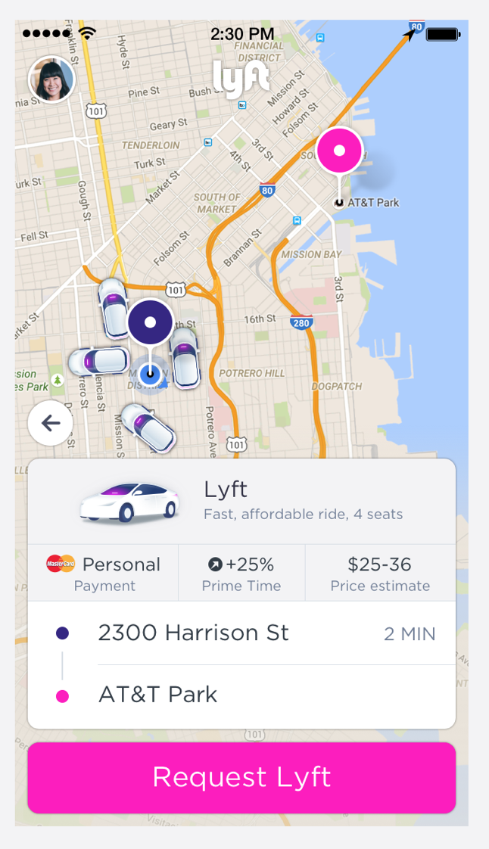
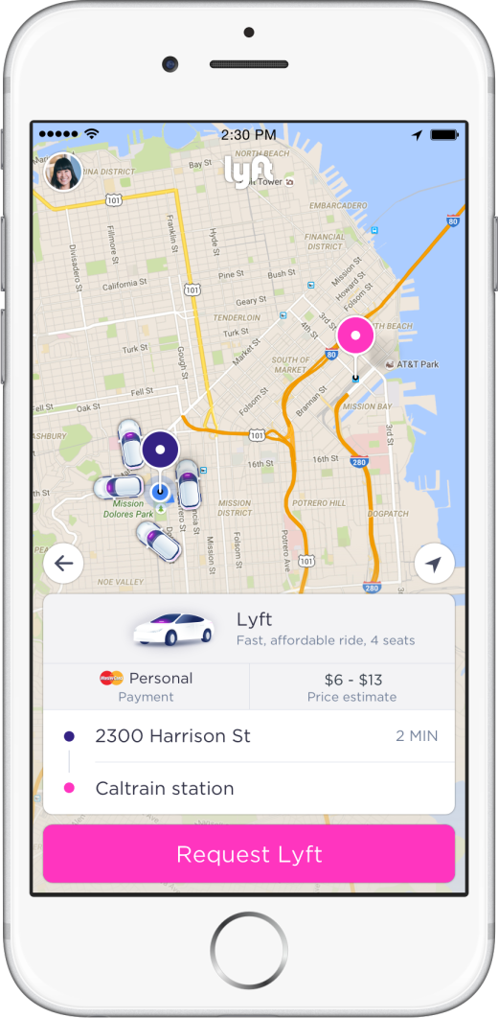
At Lyft
We randomly change the wait time and the price of a ride that customers eye-balled
Such "take it or leave it" decisions exploit the role of weak complementarity in extensive margin choices.
Weak complementarity provides a VOT estimate from two elasticities

Slide 10
Identification in Natural Field Experiment I
First field experiment: in 9 large markets randomized 40% of the Lyft customers (720,059) into one of six groups for eight weeks (5.2 million sessions):
Markets: Atlanta, Austin, Boston, Los Angeles, Miami, NYC, San Diego, San Francisco, Seattle.
Use instruments for each of these five treatment groups that provide us with exogenous variation in PT_{ij} and T_{ij}, that are independent of W_{ij} (outside options), B_{ij}, and e_{ij}.
VOT =

Slide 11
Natural Field Experiment II
Two objectives:
1. Replicate main insights and heterogeneity tests
2. Explore how level of wait time affects ETA elasticities
- Directly address the functional form issue from exp 1
We randomized location-hour blocks into one of the following four groups:
Control (10% of the city sample)
ETA plus 60 seconds (5%)
ETA plus 150 seconds (3%)
ETA plus 240 seconds (2%)
Los Angeles, San Francisco, New York City, Chicago, New Jersey, Boston, Philadelphia, Washington, D.C., Miami ,and Atlanta
Comment: No price variation (but six overlapping cities with 1st exp)

Slide 12
The Value of Time in the United States: Estimates from Nationwide Natural Field Experiments Ariel Goldszmidt, John List, Robert Metcalfe, Ian Muir, Kerry Smith & Jenny Wang
Main empirical findings:
1. Our estimated VOT ($19.40, se of 1.58) is significantly larger than current US Federal guidelines
Mean VOT is correlated with the city’s wage rate (~0.8 correlation) - and VOT is roughly 60-75% of the mean wage rate
2. Lots of heterogeneity: the timing of the time matters a lot
Morning or afternoon commute
Dinner time
Bar time
Day of the week
Week of the month

Slide 13
The Value of Time in the United States: Estimates from Nationwide Natural Field Experiments Ariel Goldszmidt, John List, Robert Metcalfe, Ian Muir, Kerry Smith & Jenny Wang
Main empirical findings:
3. Lots of heterogeneity that is consistent with standard economic theory
Higher VOT:
in peak commuting times
in higher-income areas
in locations with more outside options
for those that use ridesharing for business
4. VOT increases over longer periods of wait time – convex relationship

Slide 14
Some Products
Wait & Save
Walk & Save
Fast Pass
FEs test product variants then ML used to refine them

Slide 15
B. Economics of Crime: Police Discrimination

Slide 16
One Dismal Fact in the U.S.: Huge disparities in law enforcement during police encounters
Traffic stops are the most common cause of police-civilian interaction
Minority drivers are 3-12 percent more likely to receive a speeding citation (Makowsky & Stratmann 2009)
Minority drivers are 10-20 percent less likely to receive leniency from a ticket (Anbarci & Lee, 2014; Goncalves & Mello, 2021)
OPEN QUESTION: Is this racial discrimination?

Slide 17
Two major challenges when interpreting past work
Difficult to say whether racial disparities arise from differences in offense rates or discriminatory enforcement
Race-based selection into administrative data can lead to underestimating discrimination
E.g., if officers only stop the worst offending white drivers and a random sample of minority drivers, then comparisons across race conditional on a stop compare fundamentally different types of people
We must solve the denominator problem to overcome these inferential issues

Slide 18
We circumvent these issues using Lyft and FOI data
Lyft driver’s smartphone app communicates their location in realtime
Allows us to know the driver’s location and speed
Also have data on driver and vehicle characteristics, driving time
Combine Lyft data with administrative data from Florida
Allows us to measure traffic stops
Also have data on road and geographic characteristics

Slide 19
Two Approaches
Fixed Effects Approach
Control for year, month, day of week, hour of day, geohash, road features, driver characteristics, and vehicle characteristics.
Double Machine Learning Approach (Chernozhukov et al., 2017)
Identification similar to the fixed effects approach
Allow the machine learning algorithm to automatically learn the best specification. e.g., use of raw latitude/longitude and second of the week and day of the year and let the algorithm choose the right way to control for these variables.

Slide 20
No racial differences in speeding behavior
Figure shows the share of pings in different speeding bins
Penalties for speeding increase at each of the different bins
Drivers rarely travel more than 10 mph over the speed limit
White and minority drivers travel at similar speeds

Slide 21
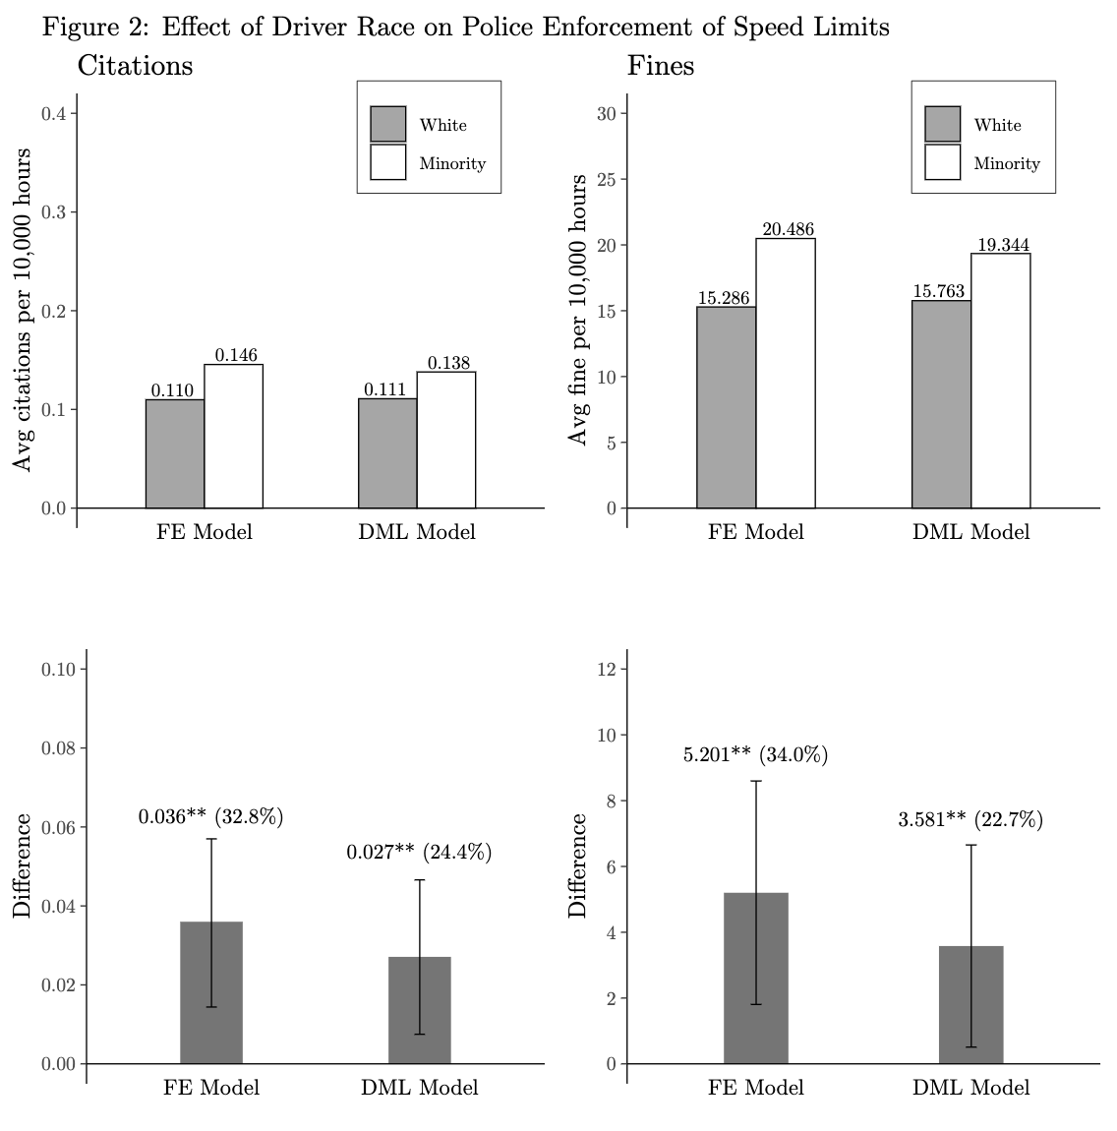
Both empirical approaches show discrimination
Minority drivers are 24 – 33 percent more likely to be stopped for speeding than white drivers traveling the same speed
Minority drivers pay 23 to 34 percent more fines than white drivers traveling the same speed

Slide 22
Ruling out alternative interpretations
Officers also consider some driving behavior other than speed
Examine whether accident rates differ by race either overall or at different speeds
Officers make decisions based on their expectations of motorist’s future driving behavior
Examine whether re-offense rates differ by race

Slide 23
No evidence of racial differences in accidents

Slide 24
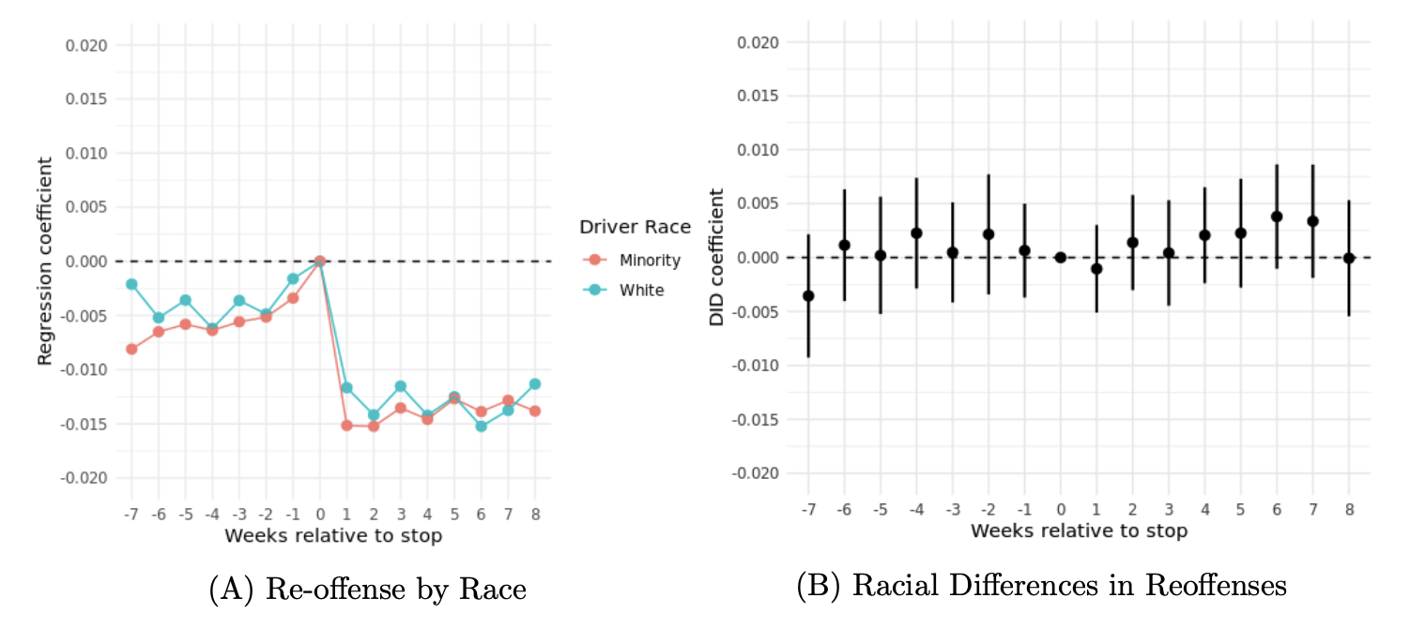
No Racial differences in re-offense rates

Slide 25
Conclusions
Police officers stop minority motorists more than white motorists driving the same speed
Lack of racial differences in accident re-offense rates rule out other driving behaviors as an explanation of differential treatment.
In the spirit of VOT, this paper offers an example of how academics and businesses can team up to advance our understanding of critical social issues

Slide 26
High-Frequency Location Data Shows That Race Affects the Likelihood of Being Stopped and Fined for Speeding
Aggarwal, Brandon, Goldszmidt, Holz, List, Muir, Sun, and Yu

Slide 27
What am I most excited about now in this space?
PROJECT GIGATON

Slide 28
Project Gigaton™: Driving action with suppliers toward Regeneration
PLANET
Aiming to reduce or avoid 1 billion MT of emissions by 2030
Cumulative 750+ million MT CO2e avoided and 5,200+ suppliers engaged since 2017
+175 million MT
CO2e avoided in FY2022
Energy
Renewable Energy
Energy Efficiency
Nature
Regenerative Agriculture
Forestry
Waste
Food, Solid Waste Reduction
Recycling, Composting
Packaging
Recycled Content
Recyclability
Reduction
Transportation
Optimized Shipping
Zero Emission Vehicles
Product Use & Design
Design Optimization
Sustainable Sourcing
Major Contributors

Slide 29
WE ARE JUST SCRATCHING THE SURFACE!

Slide 30
Law of Demand is much more behavioral than we think Left-Digit Bias at Lyft w/Ian Muir, Devin Pope, and Gregory Sun

Slide 31
Tackling Externalities From Inside The Firm The Impact of Management Practices on Employee Productivity: A Field Experiment with Airline Captains w/Gosnell and Metcalfe

Slide 32
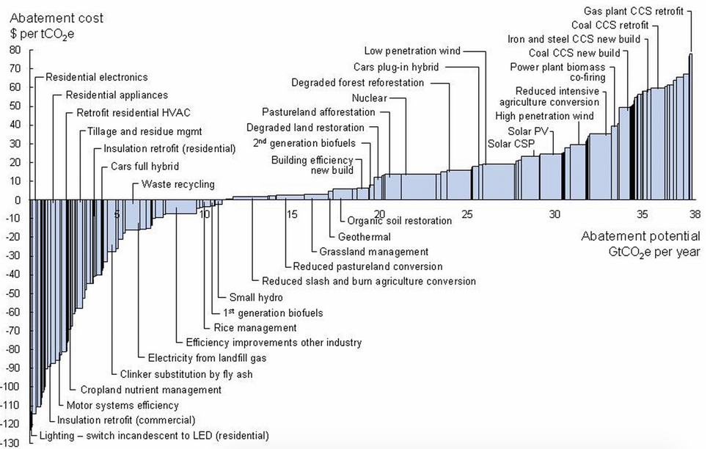
McKinsey Estimates

Slide 33
2x the negative MAC of McKinsey identified lowest-hanging fruit
-$250

Slide 34
Understanding The Gender Pay Gap The Gender Earnings Gap in the Gig Economy: Evidence from over a Million Rideshare Drivers w/Cook, Diamond, Hall, & Oyer

Slide 35
Understanding Generosity

Slide 36
Some Work
Bharat K. Chandar & Ali Hortaçsu & John A. List & Ian Muir & Jeffrey M. Wooldridge, 2019. "Design and Analysis of Cluster-Randomized Field Experiments in Panel Data Settings," NBER Working Papers 26389, National Bureau of Economic Research, Inc.
Bharat Chandar & Uri Gneezy & John A. List & Ian Muir, 2019. "The Drivers of Social Preferences: Evidence from a Nationwide Tipping Field Experiment," NBER Working Papers 26380, National Bureau of Economic Research, Inc.

Slide 37
What is the Value of Job Flexibility? "Reservation Wages and Workers’ Valuation of Job Flexibility: Evidence from a Natural Field Experiment," NBER Working Papers 27807, NBER w/Chen, Ding, & Mogstad

Slide 38
Learning By Doing is Fundamental to Understanding Productivity Differences “Toward an Understanding of Learning By Doing: Evidence from an Automobile Assembly Plant” w/Levitt & Syverson

Slide 39
Coming Soon!
Loyalty
Two studies on Customer Retention: Memberships and “Consume for Rewards” (pending lawyer approval)
Income Targeting is not as important as you think…..
“Evaluating the Evidence on Daily Income Targeting with Experimental and Observational Data” (pending author approval)

Slide 40
My View of the Landscape
Yesterday’s economist visited the pin factory to scribe general economic theories.
Today’s economist models natural disruptions that affect the pin factory and occasionally generates data from the pin factory to test economic theories.
Tomorrow’s economist will surgically control the assignment mechanism to provide causal evidence of the inner workings of the pin factory and generate data necessary to understand if learnings from that environment will transfer to other environments, be them spatially, temporally, or scale differentiated.

Slide 41
In Closing: Generation Next, Collaboration with
Due to the historical outgrowth of field experiments from social experiments, it is unsurprising that most are done in partnerships with governments and NGOs
However, field experiments in the private sector are a largely untapped opportunity
Some low hanging fruit:
Diversity & Inclusion, optimal worker incentive schemes, hierarchal arrangements, social structures and networks relating to workplace design, firm compliance with rules and regulations, worker malfeasance, wellness and health programs.
http://www.fieldexperiments.com
Why Economists Should Run Field Experiments and 14 Tips for Pulling One Off
Journal of Economic Perspectives 2011 Summer

